Slide 1
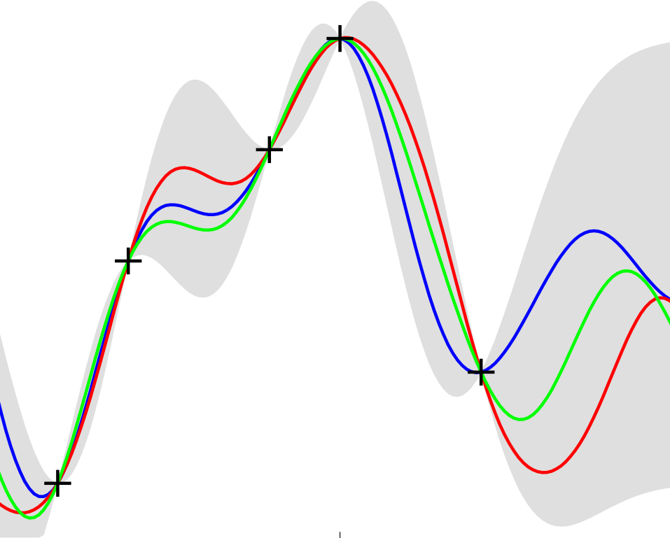
Gaussian Processes for Machine Learning
Chapter 2: Regression
Kirk Swanson
C. E. Rasmussen & C. K. I. Williams, Gaussian Processes for Machine Learning, the MIT Press, 2006, ISBN 026218253X.

Slide 2
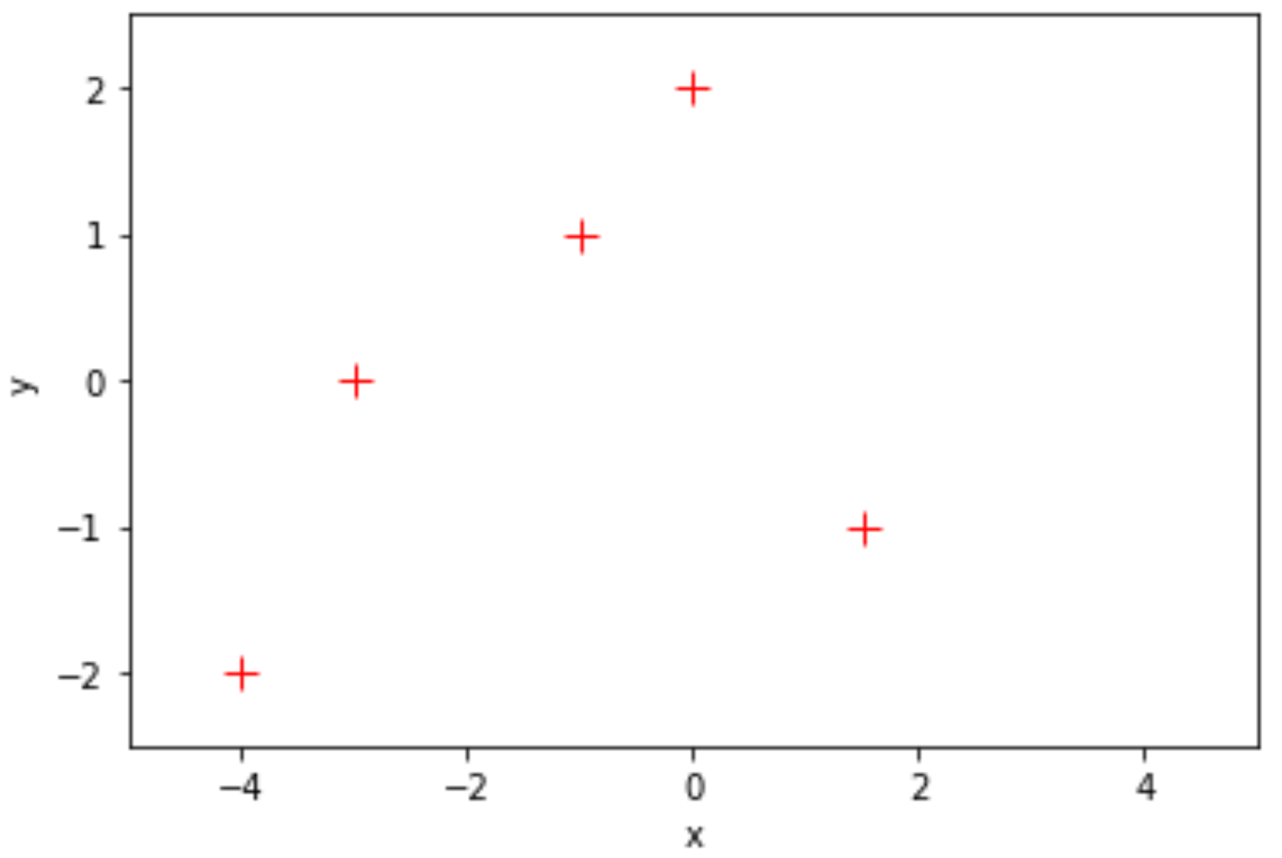
Motivation: non-linear regression
C. E. Rasmussen & C. K. I. Williams, Gaussian Processes for Machine Learning, the MIT Press, 2006, ISBN 026218253X.

Slide 3
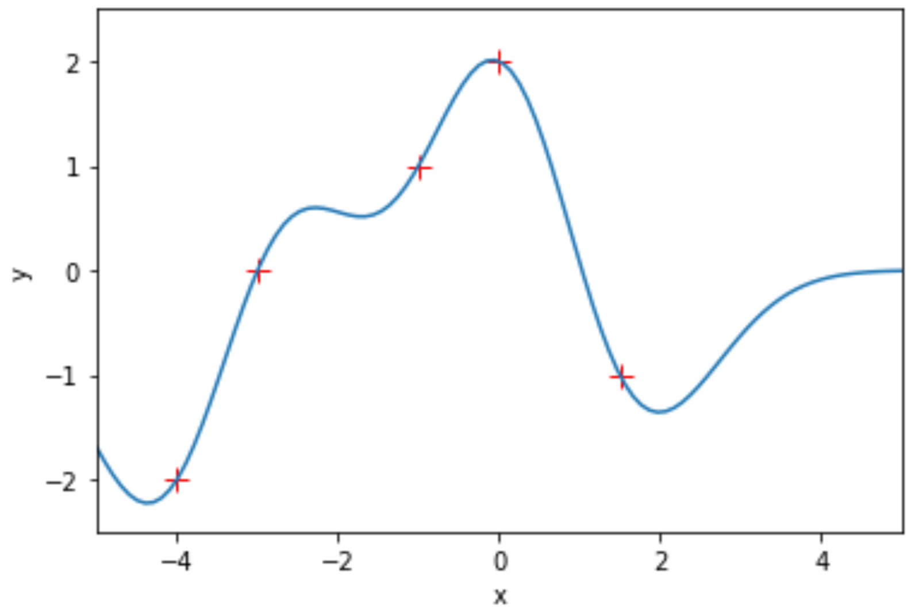
Motivation: non-linear regression
C. E. Rasmussen & C. K. I. Williams, Gaussian Processes for Machine Learning, the MIT Press, 2006, ISBN 026218253X.

Slide 4
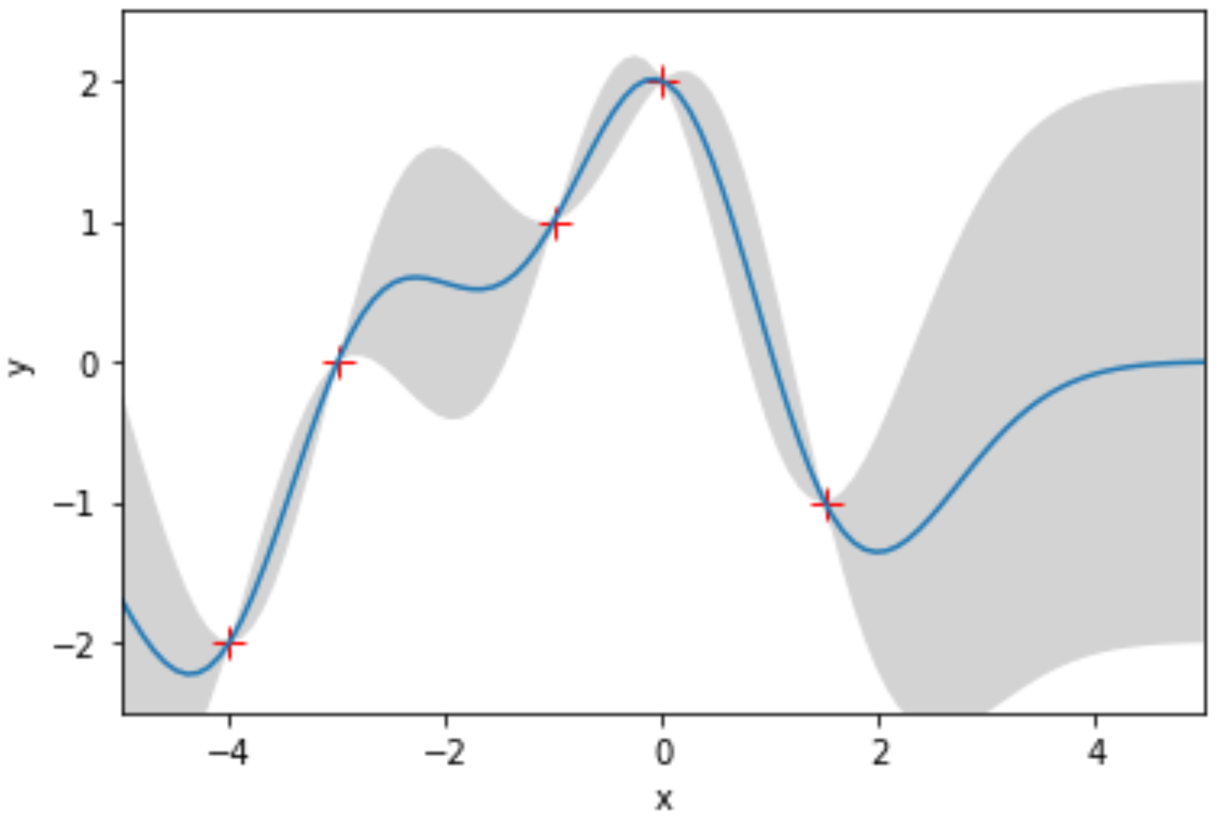
Motivation: non-linear regression
C. E. Rasmussen & C. K. I. Williams, Gaussian Processes for Machine Learning, the MIT Press, 2006, ISBN 026218253X.

Slide 5

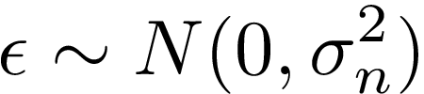
General methods for solving regression problems
Parametric Approach: select a model class
Issues: Underfitting or overfitting
C. E. Rasmussen & C. K. I. Williams, Gaussian Processes for Machine Learning, the MIT Press, 2006, ISBN 026218253X.

Slide 6
General methods for solving regression problems
Parametric Approach: select a model class
Issues: Underfitting or overfitting
Nonparametric Approach: give prior probability to every possible function
C. E. Rasmussen & C. K. I. Williams, Gaussian Processes for Machine Learning, the MIT Press, 2006, ISBN 026218253X.

Slide 7
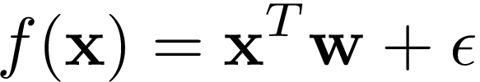
General methods for solving regression problems
Parametric Approach: select a model class
Issues: Underfitting or overfitting
Nonparametric Approach: give prior probability to every possible function
Problem: how do we compute over this uncountably infinite set?
C. E. Rasmussen & C. K. I. Williams, Gaussian Processes for Machine Learning, the MIT Press, 2006, ISBN 026218253X.

Slide 8
Gaussian process overview
Probability Distribution | Stochastic Process
Governs random variables Applies to scalar or vector values | Governs properties of functions Think (loosely) of function f as infinitely long random vector, where each entry x specifies f(x)
C. E. Rasmussen & C. K. I. Williams, Gaussian Processes for Machine Learning, the MIT Press, 2006, ISBN 026218253X.

Slide 9
Gaussian process overview
Probability Distribution | Stochastic Process
Governs random variables Applies to scalar or vector values | Governs properties of functions Think (loosely) of function f as infinitely long random vector, where each entry x specifies f(x)
Gaussian process is a generalization of the Gaussian probability distribution
C. E. Rasmussen & C. K. I. Williams, Gaussian Processes for Machine Learning, the MIT Press, 2006, ISBN 026218253X.

Slide 10
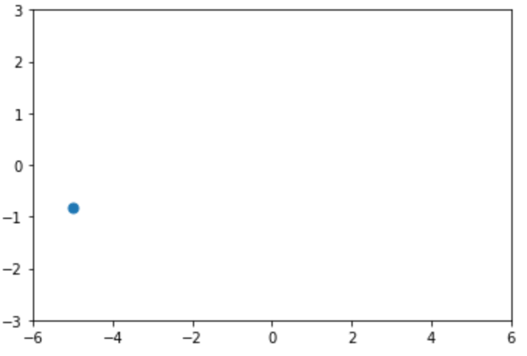


Gaussian process overview
Probability Distribution | Stochastic Process
Governs random variables Applies to scalar or vector values | Governs properties of functions Think (loosely) of function f as infinitely long random vector, where each entry x specifies f(x)
Gaussian process is a generalization of the Gaussian probability distribution
C. E. Rasmussen & C. K. I. Williams, Gaussian Processes for Machine Learning, the MIT Press, 2006, ISBN 026218253X.

Slide 11
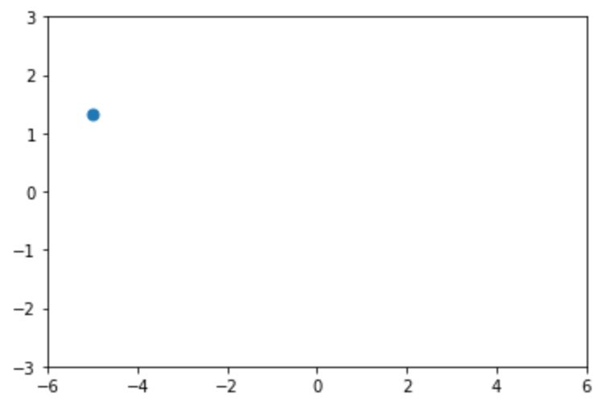
Gaussian process overview
Probability Distribution | Stochastic Process
Governs random variables Applies to scalar or vector values | Governs properties of functions Think (loosely) of function f as infinitely long random vector, where each entry x specifies f(x)
Gaussian process is a generalization of the Gaussian probability distribution
C. E. Rasmussen & C. K. I. Williams, Gaussian Processes for Machine Learning, the MIT Press, 2006, ISBN 026218253X.

Slide 12
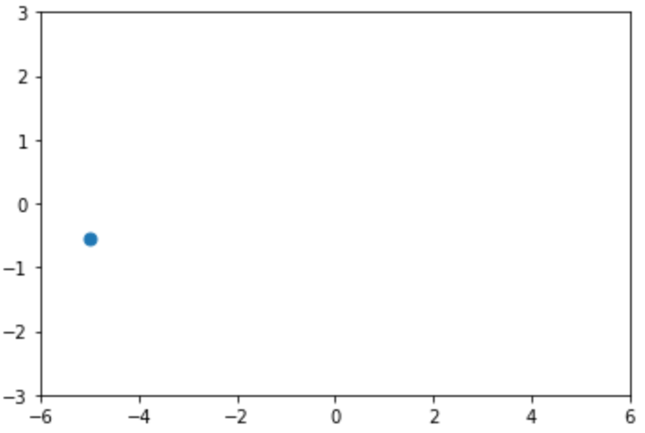
Gaussian process overview
Probability Distribution | Stochastic Process
Governs random variables Applies to scalar or vector values | Governs properties of functions Think (loosely) of function f as infinitely long random vector, where each entry x specifies f(x)
Gaussian process is a generalization of the Gaussian probability distribution
C. E. Rasmussen & C. K. I. Williams, Gaussian Processes for Machine Learning, the MIT Press, 2006, ISBN 026218253X.

Slide 13
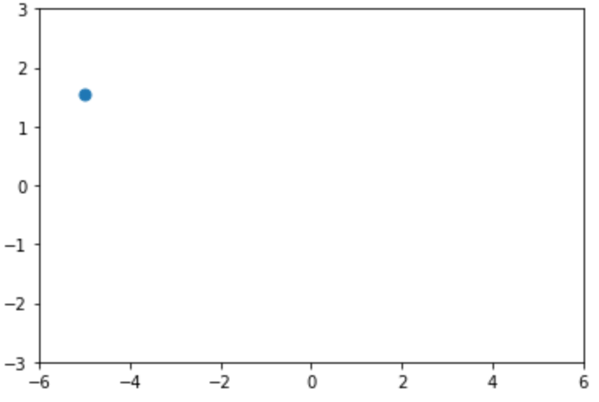
Gaussian process overview
Probability Distribution | Stochastic Process
Governs random variables Applies to scalar or vector values | Governs properties of functions Think (loosely) of function f as infinitely long random vector, where each entry x specifies f(x)
Gaussian process is a generalization of the Gaussian probability distribution
C. E. Rasmussen & C. K. I. Williams, Gaussian Processes for Machine Learning, the MIT Press, 2006, ISBN 026218253X.

Slide 14
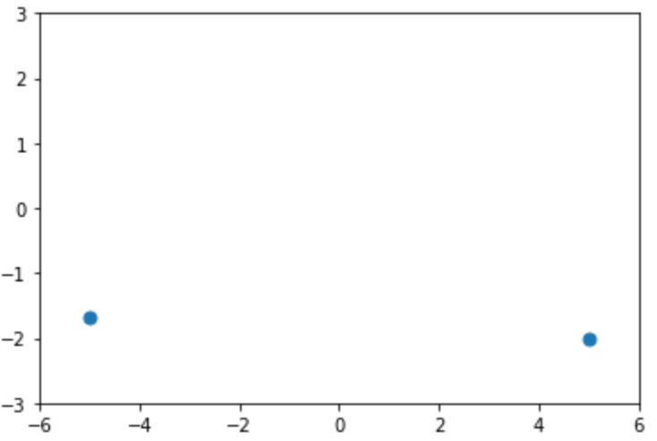
Gaussian process overview
Probability Distribution | Stochastic Process
Governs random variables Applies to scalar or vector values | Governs properties of functions Think (loosely) of function f as infinitely long random vector, where each entry x specifies f(x)
Gaussian process is a generalization of the Gaussian probability distribution
C. E. Rasmussen & C. K. I. Williams, Gaussian Processes for Machine Learning, the MIT Press, 2006, ISBN 026218253X.

Slide 15
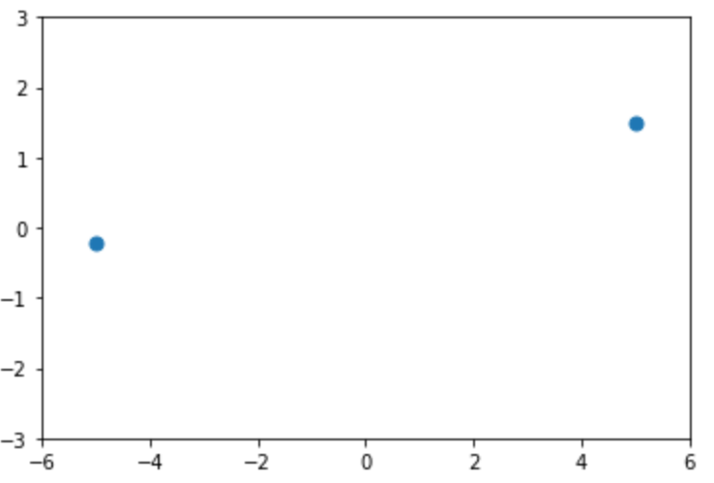
Gaussian process overview
Probability Distribution | Stochastic Process
Governs random variables Applies to scalar or vector values | Governs properties of functions Think (loosely) of function f as infinitely long random vector, where each entry x specifies f(x)
Gaussian process is a generalization of the Gaussian probability distribution
C. E. Rasmussen & C. K. I. Williams, Gaussian Processes for Machine Learning, the MIT Press, 2006, ISBN 026218253X.

Slide 16
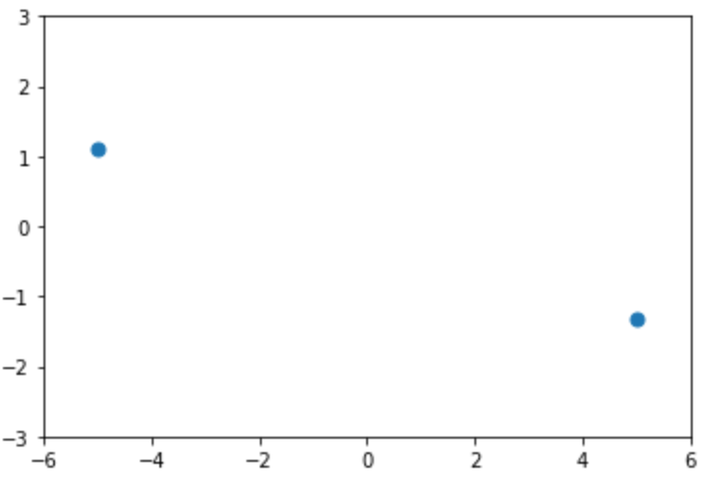
Gaussian process overview
Probability Distribution | Stochastic Process
Governs random variables Applies to scalar or vector values | Governs properties of functions Think (loosely) of function f as infinitely long random vector, where each entry x specifies f(x)
Gaussian process is a generalization of the Gaussian probability distribution
C. E. Rasmussen & C. K. I. Williams, Gaussian Processes for Machine Learning, the MIT Press, 2006, ISBN 026218253X.

Slide 17
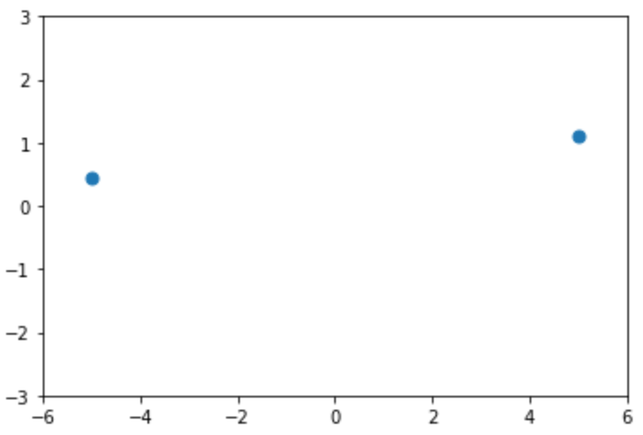
Gaussian process overview
Probability Distribution | Stochastic Process
Governs random variables Applies to scalar or vector values | Governs properties of functions Think (loosely) of function f as infinitely long random vector, where each entry x specifies f(x)
Gaussian process is a generalization of the Gaussian probability distribution
C. E. Rasmussen & C. K. I. Williams, Gaussian Processes for Machine Learning, the MIT Press, 2006, ISBN 026218253X.

Slide 18
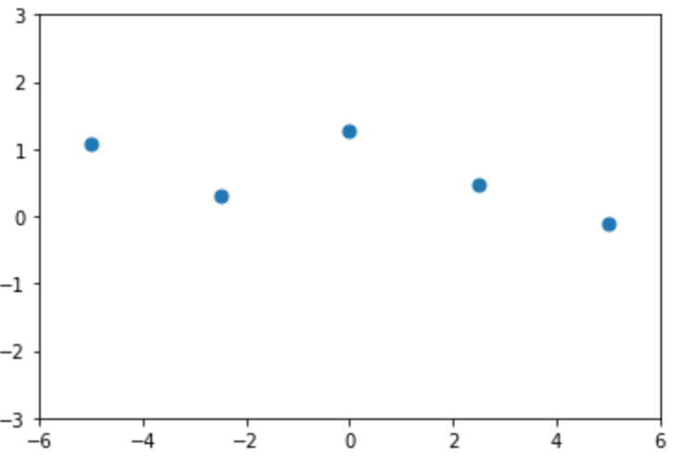
Gaussian process overview
Probability Distribution | Stochastic Process
Governs random variables Applies to scalar or vector values | Governs properties of functions Think (loosely) of function f as infinitely long random vector, where each entry x specifies f(x)
Gaussian process is a generalization of the Gaussian probability distribution
C. E. Rasmussen & C. K. I. Williams, Gaussian Processes for Machine Learning, the MIT Press, 2006, ISBN 026218253X.

Slide 19
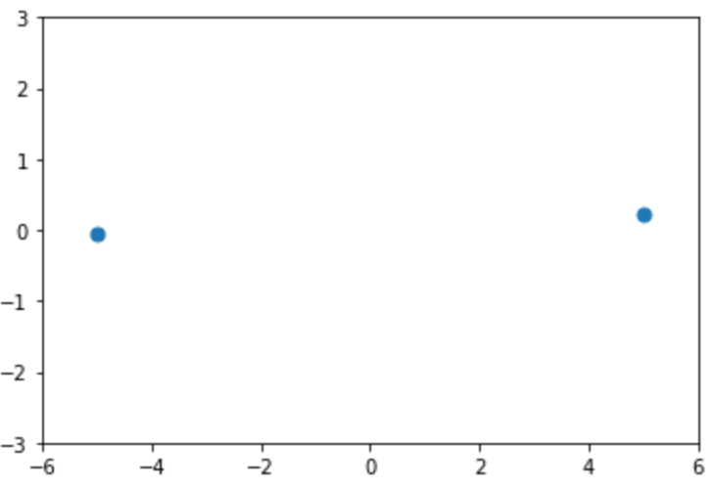
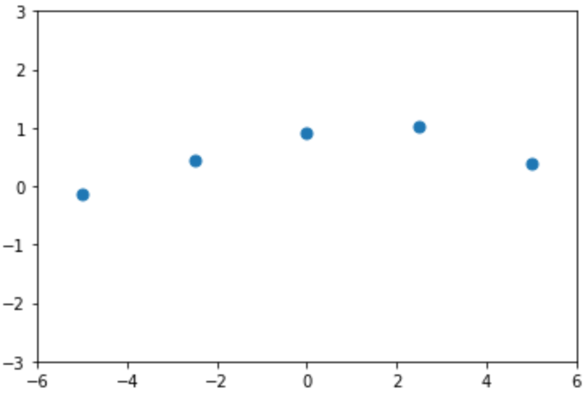
Gaussian process overview
Probability Distribution | Stochastic Process
Governs random variables Applies to scalar or vector values | Governs properties of functions Think (loosely) of function f as infinitely long random vector, where each entry x specifies f(x)
Gaussian process is a generalization of the Gaussian probability distribution
C. E. Rasmussen & C. K. I. Williams, Gaussian Processes for Machine Learning, the MIT Press, 2006, ISBN 026218253X.

Slide 20
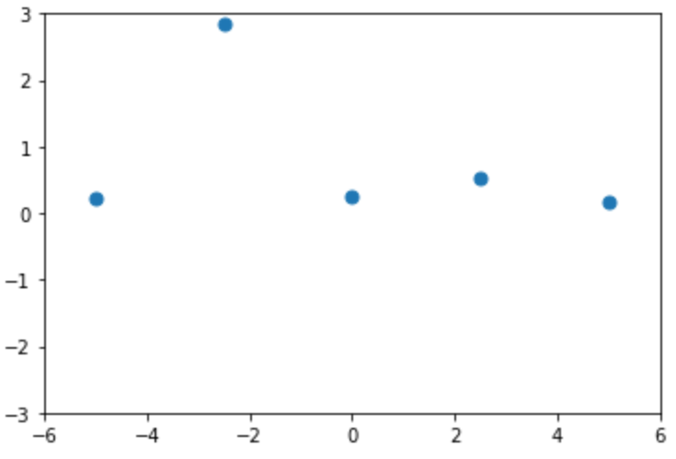
Gaussian process overview
Probability Distribution | Stochastic Process
Governs random variables Applies to scalar or vector values | Governs properties of functions Think (loosely) of function f as infinitely long random vector, where each entry x specifies f(x)
Gaussian process is a generalization of the Gaussian probability distribution
C. E. Rasmussen & C. K. I. Williams, Gaussian Processes for Machine Learning, the MIT Press, 2006, ISBN 026218253X.

Slide 21
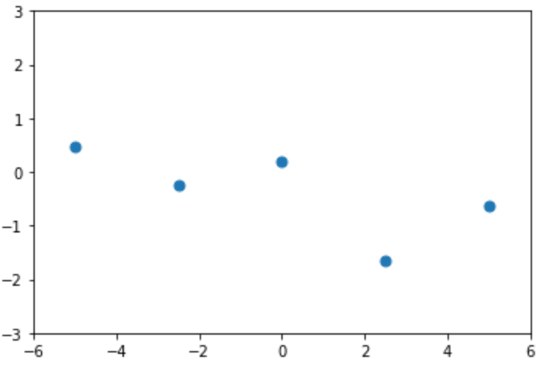
Gaussian process overview
Probability Distribution | Stochastic Process
Governs random variables Applies to scalar or vector values | Governs properties of functions Think (loosely) of function f as infinitely long random vector, where each entry x specifies f(x)
Gaussian process is a generalization of the Gaussian probability distribution
C. E. Rasmussen & C. K. I. Williams, Gaussian Processes for Machine Learning, the MIT Press, 2006, ISBN 026218253X.

Slide 22
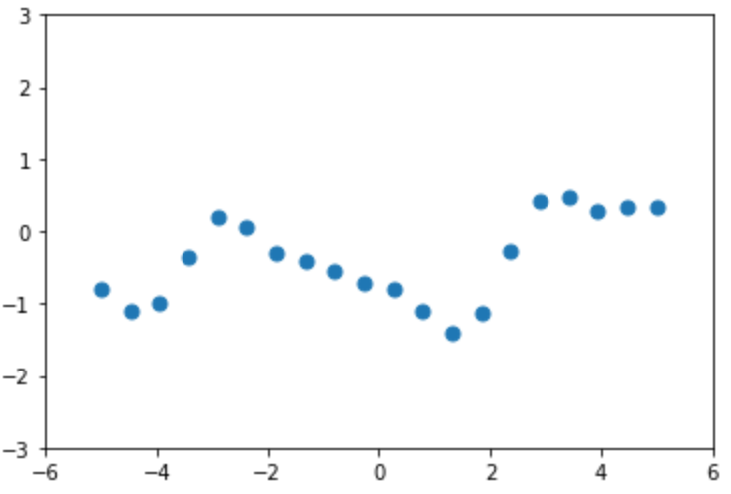
Gaussian process overview
Probability Distribution | Stochastic Process
Governs random variables Applies to scalar or vector values | Governs properties of functions Think (loosely) of function f as infinitely long random vector, where each entry x specifies f(x)
Gaussian process is a generalization of the Gaussian probability distribution
C. E. Rasmussen & C. K. I. Williams, Gaussian Processes for Machine Learning, the MIT Press, 2006, ISBN 026218253X.

Slide 23
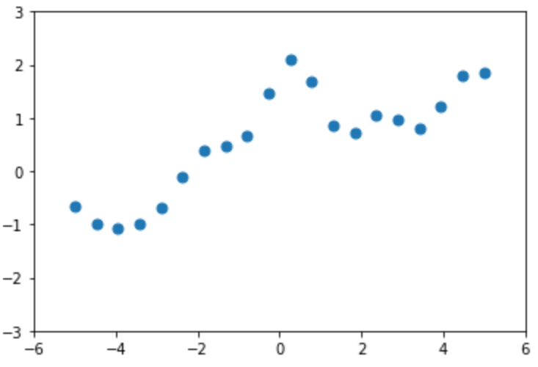
Gaussian process overview
Probability Distribution | Stochastic Process
Governs random variables Applies to scalar or vector values | Governs properties of functions Think (loosely) of function f as infinitely long random vector, where each entry x specifies f(x)
Gaussian process is a generalization of the Gaussian probability distribution
C. E. Rasmussen & C. K. I. Williams, Gaussian Processes for Machine Learning, the MIT Press, 2006, ISBN 026218253X.

Slide 24
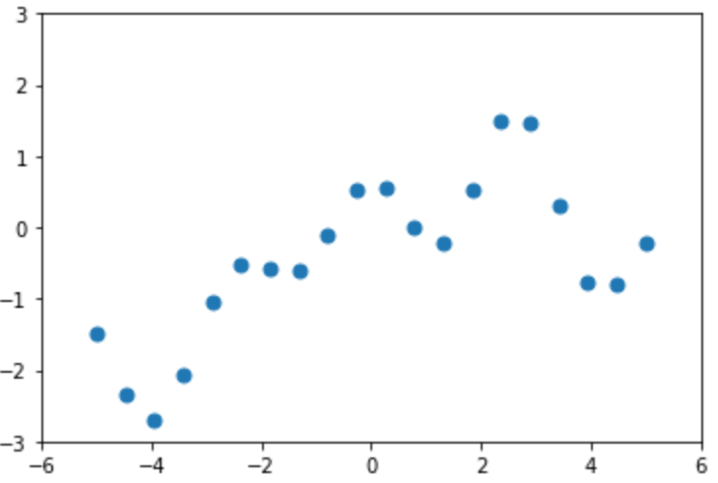
Gaussian process overview
Probability Distribution | Stochastic Process
Governs random variables Applies to scalar or vector values | Governs properties of functions Think (loosely) of function f as infinitely long random vector, where each entry x specifies f(x)
Gaussian process is a generalization of the Gaussian probability distribution
C. E. Rasmussen & C. K. I. Williams, Gaussian Processes for Machine Learning, the MIT Press, 2006, ISBN 026218253X.

Slide 25
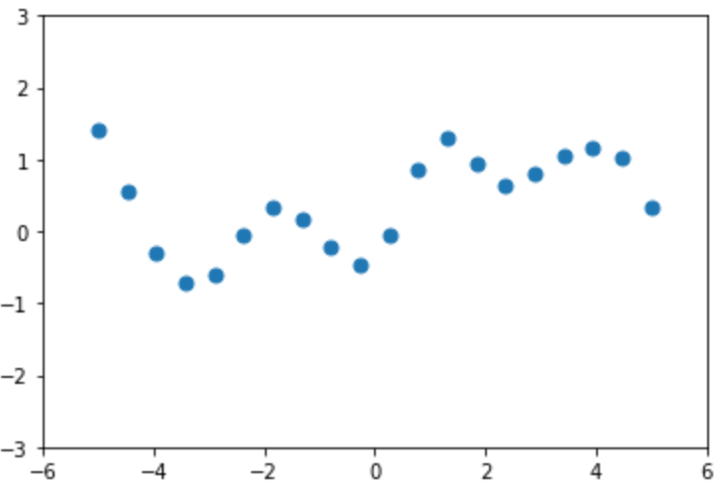
Gaussian process overview
Probability Distribution | Stochastic Process
Governs random variables Applies to scalar or vector values | Governs properties of functions Think (loosely) of function f as infinitely long random vector, where each entry x specifies f(x)
Gaussian process is a generalization of the Gaussian probability distribution
C. E. Rasmussen & C. K. I. Williams, Gaussian Processes for Machine Learning, the MIT Press, 2006, ISBN 026218253X.

Slide 26
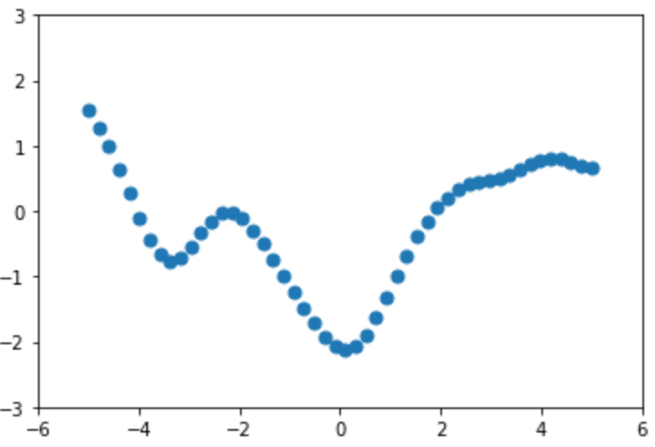
Gaussian process overview
Probability Distribution | Stochastic Process
Governs random variables Applies to scalar or vector values | Governs properties of functions Think (loosely) of function f as infinitely long random vector, where each entry x specifies f(x)
Gaussian process is a generalization of the Gaussian probability distribution
C. E. Rasmussen & C. K. I. Williams, Gaussian Processes for Machine Learning, the MIT Press, 2006, ISBN 026218253X.

Slide 27
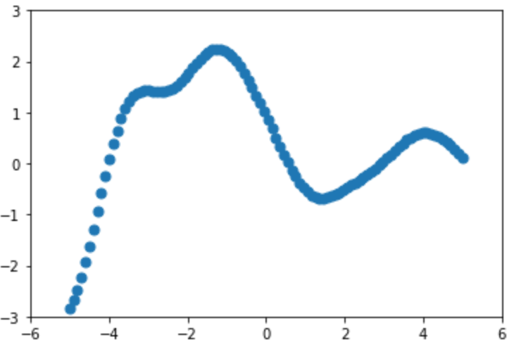
Gaussian process overview
Probability Distribution | Stochastic Process
Governs random variables Applies to scalar or vector values | Governs properties of functions Think (loosely) of function f as infinitely long random vector, where each entry x specifies f(x)
Gaussian process is a generalization of the Gaussian probability distribution
C. E. Rasmussen & C. K. I. Williams, Gaussian Processes for Machine Learning, the MIT Press, 2006, ISBN 026218253X.

Slide 28
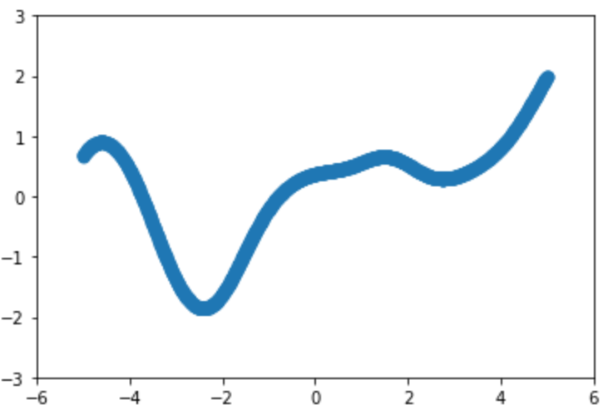
Gaussian process overview
Probability Distribution | Stochastic Process
Governs random variables Applies to scalar or vector values | Governs properties of functions Think (loosely) of function f as infinitely long random vector, where each entry x specifies f(x)
Gaussian process is a generalization of the Gaussian probability distribution
C. E. Rasmussen & C. K. I. Williams, Gaussian Processes for Machine Learning, the MIT Press, 2006, ISBN 026218253X.

Slide 29
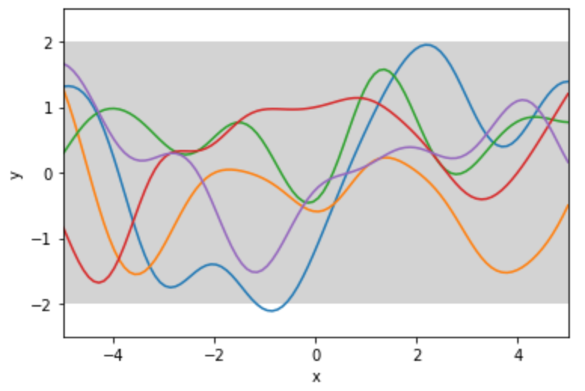
Pictorial example
prior
C. E. Rasmussen & C. K. I. Williams, Gaussian Processes for Machine Learning, the MIT Press, 2006, ISBN 026218253X.

Slide 30
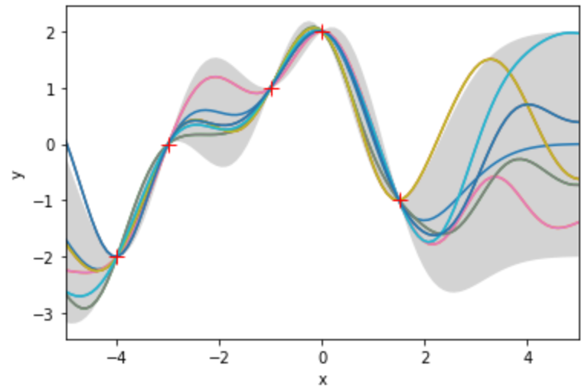
Pictorial example
prior
posterior
C. E. Rasmussen & C. K. I. Williams, Gaussian Processes for Machine Learning, the MIT Press, 2006, ISBN 026218253X.

Slide 31

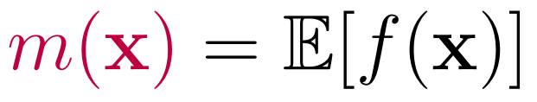

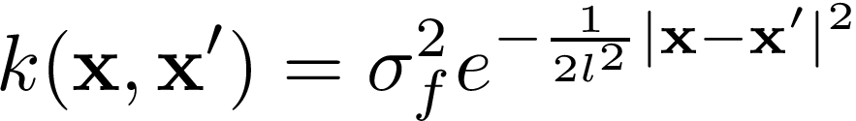





Gaussian process definition
A Gaussian Process is a collection of random variables, any finite number of which have a joint Gaussian distribution
Mean function
Covariance function
“squared exponential” (SE) or “radial basis function”:
Correspondence with
Gaussian distribution
random variable for the case
infinitely long mean vector
infinite-dimensional covariance matrix:
C. E. Rasmussen & C. K. I. Williams, Gaussian Processes for Machine Learning, the MIT Press, 2006, ISBN 026218253X.

Slide 32
Key insight: “If you only ask for the properties of the function at a finite number of points, then inference in the Gaussian process will give you the same answer if you ignore the infinitely many other points, as if you would have taken them all into account!”
C. E. Rasmussen & C. K. I. Williams, Gaussian Processes for Machine Learning, the MIT Press, 2006, ISBN 026218253X.

Slide 33






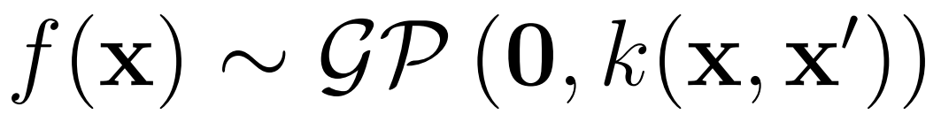
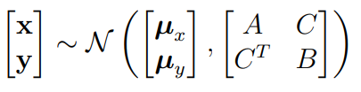
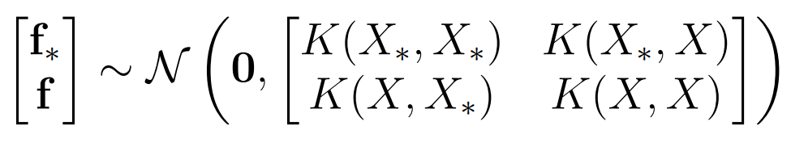
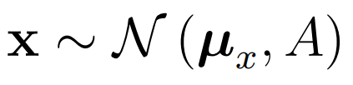

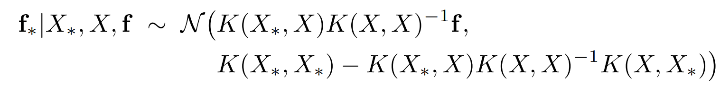
Marginalization property makes Gaussian processes tractable
Multivariate Gaussian distribution
Gaussian process
Variables
Let and be jointly Gaussian random vectors.
Let be a matrix of inputs with corresponding outputs . Let be a different matrix of inputs with corresponding outputs . Let .
Joint
Marginalization Property
Marginal
Conditional
C. E. Rasmussen & C. K. I. Williams, Gaussian Processes for Machine Learning, the MIT Press, 2006, ISBN 026218253X.

Slide 34





Marginalization property makes Gaussian processes tractable
Multivariate Gaussian distribution
Gaussian process
Variables
Let and be jointly Gaussian random vectors.
Let be a matrix of inputs with corresponding outputs . Let be a different matrix of inputs with corresponding outputs . Let .
Joint
Marginalization Property
Marginal
Conditional
C. E. Rasmussen & C. K. I. Williams, Gaussian Processes for Machine Learning, the MIT Press, 2006, ISBN 026218253X.

Slide 35


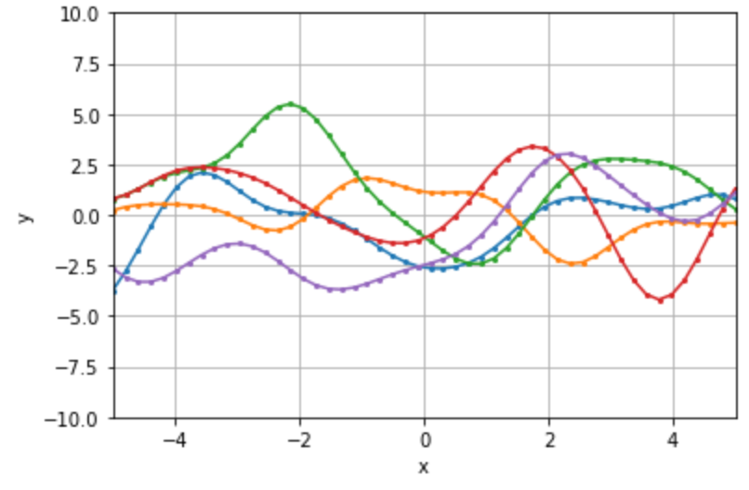

Gaussian process gives a prior distribution over functions
Prior distribution of outputs via marginalization property:
Covariance function encodes function attributes:
Functions are smooth (SE is differentiable)
characteristic length scale
overall variance
Jupyter notebook examples
Functions drawn from prior
hyperparameters
C. E. Rasmussen & C. K. I. Williams, Gaussian Processes for Machine Learning, the MIT Press, 2006, ISBN 026218253X.

Slide 36



Prediction with noise-free observations
Empirical dataset
Test points
Model
Joint distribution (via marginalization property)
Conditional distribution
Restricts the prior distribution to contain only those samples which agree with the observations
Jupyter notebook example: drawing samples from this posterior distribution
C. E. Rasmussen & C. K. I. Williams, Gaussian Processes for Machine Learning, the MIT Press, 2006, ISBN 026218253X.

Slide 37


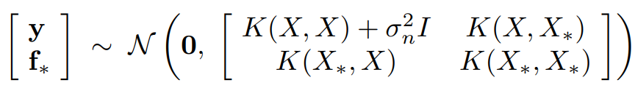





Prediction with noisy observations
It is typical for more realistic modelling situations that we do not have access to function values themselves, but noisy measurements thereof:
Prior on observations becomes:
We can then write the joint distribution of the observed target values and the function values at the test locations as:
This yields the following conditional distribution:
C. E. Rasmussen & C. K. I. Williams, Gaussian Processes for Machine Learning, the MIT Press, 2006, ISBN 026218253X.

Slide 38
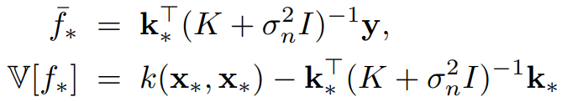
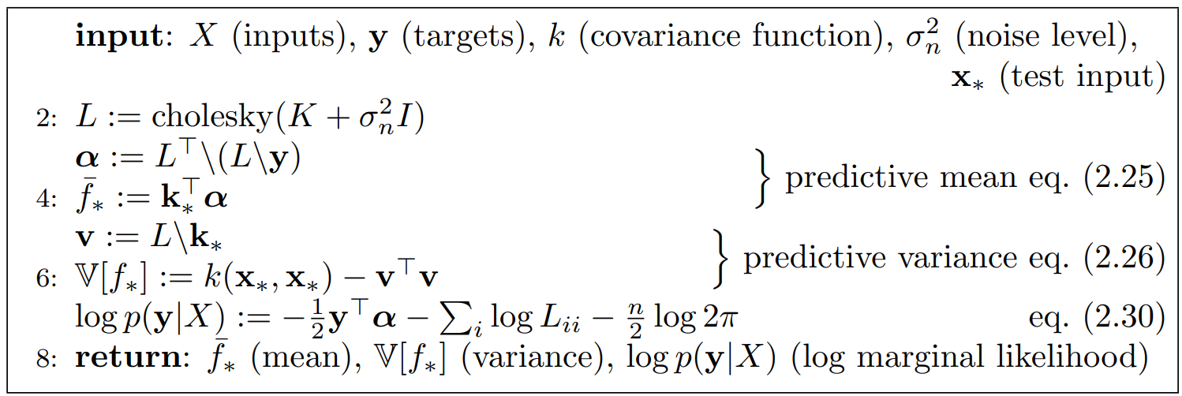
Prediction with noisy observations: single test point
Let x* be a single test input, and let k* denote the vector of covariances between the test point and the training points:
Discuss O(n^3) costs for different approaches
In the case that there is only one test point x*, let k* denote the vector of covariances between the test point and the n training points:
Eqn. (2.25) and (2.26)
Comments:
The mean prediction Eqn. (2.25) is a linear combination of the observations, y. So it is sometimes referred to as a linear predictor. Although the GP defines a joint Gaussian distribution over all of the y variables, one for each point in Chi, for making predictions at x*, we only care about the n+1-dimensional distribution defined by taking n training points and the test point.
Also note that the variance in Eqn. 2.24 only depends on the inputs, not the observed targets. The first term is the prior covariance, and from that is subtracted a positive term representing the information the observations give us about the function.
C. E. Rasmussen & C. K. I. Williams, Gaussian Processes for Machine Learning, the MIT Press, 2006, ISBN 026218253X.

Slide 39
Supervised learning: regression
Def’n: Learning input-output mappings from empirical data
Regression + classification
We will focus on regression
Notation:
Input is a vector x (bold) and output is a scalar y, which is continuous in the regression case
Dataset of n observations, called the “training data”, is denoted D = {(x_i, y_)|i = 1,…,n}
Given this training data, we wish to make predictions for new inputs x_*, that we have not seen in the training data.

Slide 40
Regression
This means we want to construct a model function, f, based on the training data D, which can make accurate predictions for all possible input values.
Speaking very generally, one possible approach is to choose a specific class of functions, for example linear functions of the input, and then optimize the parameters of this model, e.g. OLS regression:
F = X^Tw + e_i, optimize w.
However, this involves identifying an appropriate class of functions, which could either be too restrictive and not perform well on the training data or too flexible and tend towards overfitting. “restriction bias”
Another possible approach is to give a prior probability to every possible function, and then place higher probabilities on functions that are more likely than others given the training data. “preference bias”
However, this involves an uncountably infinite set of possible functions – how do we compute over this?

Slide 41
Gaussian Process
A Gaussian process is a generalization of the Gaussian probability distribution.
Whereas a probability distribution describes random variables which are scalars or vectors (for multivariate distributions), a stochastic process governs the properties of functions. Loosely speaking, one can think of a function f:R -> y as an infinitely long vector, where each entry in the vector specifies the function value f(x) at a particular value x. In other words, it’s kind of like every point on the real line corresponds to a random variable, whose value corresponds to the value of the function at that point.
Key insight: Through marginalization and conditioning, we can perform inference at a finite number of points, so from a practical computational standpoint, we do not need to compute probabilities over an infinite joint distribution.
If you only ask for the properties of the function at a finite number of points, then inference in the Gaussian process will give you the same answer if you ignore the infinitely many other points, as if you would have taken them all into account!

Slide 42
Pictorial Example
1-d regression problem
First, define a prior distribution over functions specified by a Gaussian process. Average value over functions at each x is 0, At any value of x there is a variance (pointwise variance). Also, the functions have other general properties, such as that they are smooth and stationary and vary only moderately. As we shall see, the mean at each x is specified by a mean function, while the pointwise variance and general properties of the functions are determined by a “covariance function”. Figure 1.1(a).
Suppose that we are now given a dataset consisting of two observations, and we wish to now only consider functions that pass two these points exactly. Figure 1.1(b). Uncertainty is reduced close to these points. The combination of prior and data leads to this posterior distribution over the possible functions.

Slide 43
Formal Definition
A Gaussian process is a collection of random variables, any finite number of which have a joint Gaussian distribution.
We can already see in this definition the finite inference solution.
We mentioned the mean function and covariance function before, and here I will explicitly define them.
We define:
Mean function: m(x) = E[f(x)]
Covariance function: k(x, x’) = E[(f(x) – m(x))(f(x’) – m(x’)]
Effectively specifies the entries of an infinite-dimensional covariance matrix
Gaussian process: f(x) ~ GP(m(x), k(x, x’))
Chi: set of possible inputs
f_i = f(x_i) is the random variable corresponding to the case (x_i, y_i)
In other cases, GPs can be defined over time

Slide 44
Marginalization Property and Conditional Distributions
The multivariate Gaussian distribution has a joint probability density given by:
Eqn. A.4
Let x and y be jointly Gaussian random vectors:
Eqn. A.5
Then, the marginal distribution of x is:
Eqn. A.6
The conditional distribution of x given y is:
Eqn. A.6
Gaussian distribution is marginalized by just taking the relevant block of the joint covariance matrix.
This property is also known as consistency, and it is fulfilled if the covariance function specifies entries of the covariance matrix. (have answer for why? b/c cov function gives you all the information you need about how the finite collection of r.v.s interact with each other)
This property is what allows us to do finite inference from an infinite joint distribution, makes the problem computationally tractable.
SHOULD I INCLUDE A PROOF????

Slide 45
Mean and Covariance Function
For now we will choose m = 0
Cov is the squared exponential (also called the Radial Basis Function):
Eqn. 2.16
Covariance between the outputs is written as a function of the inputs. Covariance is almost 1 between variables whose corresponding inputs are very close, and decreases as distance in input space increases.
Why this form? Can be shown that SE covariance corresponds to a Bayesian linear regression model with an infinite number of basis functions. For every positive definite covariance function, there exists a (possibly infinite) expansion in terms of basis functions. This is the connection to the first section.
Characteristic variance and length scale (show examples from jupyter notebook next slides)

Slide 46
GP prior
GP gives is a distribution over functions, prior since we haven’t seen any data
We can sample from this distribution by checking values at a finite number of points, using the marginalization property. We generate a Gaussian random vector from this distribution:
Eqn. 2.17, values of the covariance matrix are generated from the covariance function, so if we have input data points x_i and x_j, then k(x_i, x_j) gives the corresponding covariance in the covariance matrix.
Show examples from jupyter notebook, including different values of the variance and length scale. Smooth as SE cov function is infinitely differentiable.

Slide 47
Prediction with Observations
We are not so interested in drawing random functions from the prior, but we want to incorporate knowledge from training data to make informed predictions.
Two cases: noise-free and noisy. The idea is that there is some true underlying function, such as the sin function. In the noise-free case, our training data consists of values that correspond exactly to values of this underlying function. In the noisy case, the idea is that our measurements of this function have some noise, or error associated with them, so noisy sin measurements. Give pictorial examples of noise-free and noisy observations.

Slide 48
Prediction with Noise-Free Observations
Training data is {(x_i, f_i)|I = 1,…,n}. Test data is X*. We will model f using a GP with 0 mean and SE covariance function.
According to the marginalization property, the joint distribution of the training outputs, f, and the test outputs, f*, according to the prior is:
Eqn. 2.18.
If there are n training points and n* test points then K(X, X*) denotes the n x n* matrix of covariances evaluated at all pairs of training and test points, and similarly for the other entries K.
To get the posterior distribution over functions we need to restrict this joint prior distribution to contain only those functions which agree with the observed data points.
We could imagine implementing a rejection sampling scheme, but not computationally feasible.

Slide 49
Prediction with Noise-Free Observations
Instead of impractical rejection sampling, we can use the marginalization property and the definition of Gaussian conditioning to give the following distribution:
Eqn. (2.19)
We sample function values according to this distribution by evaluating the mean and covariance matrices.
Show results in Jupyter notebook.

Slide 50
Prediction with Noisy Observations
It is typical for more realistic modelling situations that we do not have access to function values themselves, but noisy measurements thereof, y = f(x) + epsilon. If we assume i.i.d. Gaussian noise e with variance sigma_n, then the prior on the noisy observations becomes
Eqn. (2.20)
This follows from the independence function about the noise that a diagonal matrix is added
We can then write the joint distribution of the observed target values and the function values at the test locations as:
Eqn. (2.21)
Using the same conditional distribution rules, we have:
Eqns. (2.22 – 2.24)
Can compute the predictive distribution of test targets y* by adding sigma_n^2 I to the variance in Eqn. 2.24.

Slide 51
Simplification: Predicting One Test Point with Noisy Observations
In the case that there is only one test point x*, let k* denote the vector of covariances between the test point and the n training points:
Eqn. (2.25) and (2.26)
Comments:
The mean prediction Eqn. (2.25) is a linear combination of the observations, y. So it is sometimes referred to as a linear predictor. Although the GP defines a joint Gaussian distribution over all of the y variables, one for each point in Chi, for making predictions at x*, we only care about the n+1-dimensional distribution defined by taking n training points and the test point.
Also note that the variance in Eqn. 2.24 only depends on the inputs, not the observed targets. The first term is the prior covariance, and from that is subtracted a positive term representing the information the observations give us about the function.

Slide 52
Practical Algorithm
Uses Cholesky decomposition instead of matrix inversion since it is faster and more numerically stable.
Section A.4 explanation of Cholesky decomposition.
Algorithm 2.1 (to get predictive distribution for y*, simply add the noise variance sigma_n^2 to the predictive variance of f*).

Slide 53
Why GPs?? – very flexible tool that can be applied to a wide variety of problems, book mentions that many problems are special cases of GPs, and also deep learning stuff in second presentation Comparison to other methods (in theory and in code?) Why is mean function 0? Cholesky decomposition Relationship to Bayesian linear regression Downside – not that data efficient Learning hyperparameters: argmax_{l, sigma^2} log(probability of evidence – marginal likelihood) Other covariance functions: absolute value – Brownian motion – need positive semi-definite matrices Positive semi-definite is a property of covariance matrices, so kernel function needs to yield this. Different covariance functions are appropriate for different problems, rules for composing them like taking the product. Could do Bayesian model comparison. Gauss-Markov process – Kalman filter Brownian motion GP not have to be regression – classification, unsupervised learning…it is really about having a prior over functions Large datasets: - More than 10s of thousands we start to get in trouble - Summarize data by small number of pseudo-data - Split up data in chunks and stitch up boundaries - Expectation Propagation pseudo-point approximation – it finds a set of pseudodata such that the approximate posterior is as close as possible to the true posterior (O(NM^2)), M order of 1000 - Neural network with an infinite hidden layer is equivalent to a Gaussian process, if have gaussian prior on weights, then the sort of functions it implements is equivalent to a Gaussian process GP gives well-calibrated uncertainty estimates (unlike neural networks, output probabilities usually close to 1 or 0 for classification), can give a big model from small data Parametric model: capacity of parameters sets the capacity of model. But nonparametric model has infinite capacity, so generalization to test data not as much of an issue. Problem: single-layered, so can’t learn hierarchical relationships DGP – automatic kernel learning

